Slide 1
Recommendation System
JC DATA SCIENCE
Python For Machine Learning

Slide 2
1. What is RS?
A recommender system or a recommendation system (sometimes replacing 'system' with a synonym such as platform or engine) is a subclass of information filtering system that seeks to predict the "rating" or "preference" a user would give to an item. They are primarily used in commercial applications ~ wikipedia.

Slide 3

2. Why We Need RS??
Which book should I read?

Slide 4
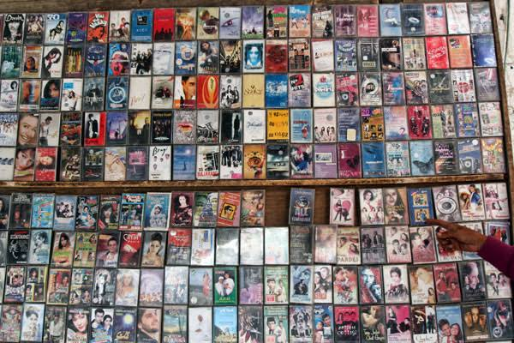
2. Why We Need RS??
Which movie should I watch?

Slide 5
3. four types of RS
Demographic Filtering
Content Based
Collaborative Filtering
Hybrid

Slide 6
4. Demographic Filtering
Decide on the metric or score to rate items on.
Calculate the score for every item
Sort the item based on the score and output the top results
Its also called simple recommenders
Its offers generalized recommnendations to every user, not personalized recommendation

Slide 7
5. Content Based Filtering
Content-based filtering uses item features to recommend other items similar to what the user likes, based on their previous actions or explicit feedback.
These methods are best suited to situations where there is known data on an item (name, location, description, etc.), but not on the user (user rating, user review, etc).

Slide 8
5. Content Based Filtering
Advantages
The model doesn't need any data about other users, since the recommendations are specific to this user. This makes it easier to scale to a large number of users.
The model can capture the specific interests of a user, and can recommend niche items that very few other users are interested in.

Slide 9
5. Content Based Filtering
Disadvantages
The model can only make recommendations based on existing interests of the user. In other words, the model has limited ability to expand on the users' existing interests.
Since the feature representation of the items are hand-engineered to some extent, this technique requires a lot of domain knowledge. Therefore, the model can only be as good as the hand-engineered features.

Slide 10
6. Collaborative Filtering
Collaborative filtering is based on the assumption that people who agreed in the past will agree in the future, and that they will like similar kinds of items as they liked in the past.
To address some of the limitations of content-based filtering, collaborative filtering uses similarities between users and items simultaneously to provide recommendations.

Slide 11
6. Collaborative Filtering
A key advantage of the collaborative filtering approach is that it does not rely on machine analyzable content and therefore it is capable of accurately recommending complex items such as movies without requiring an "understanding" of the item itself.
When building a model from a user's behavior, a distinction is often made between explicit and implicit forms of data collection.

Slide 12
6. CF Data Collection
Expicit data collection Examples
Asking a user to rate an item on a sliding scale.
Asking a user to search.
Asking a user to rank a collection of items from favorite to least favorite.
Implicit data collection Examples
Observing the items that a user views in an online store.
Analyzing item/user viewing times.
Keeping a record of the items that a user purchases online.

Slide 13
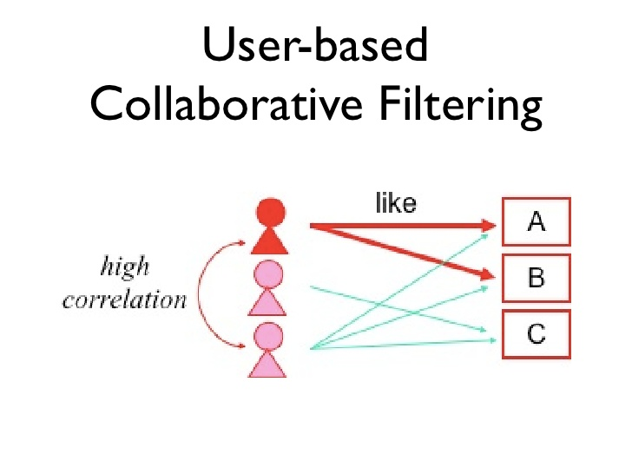
6. CF User based vs Item Based

Slide 14
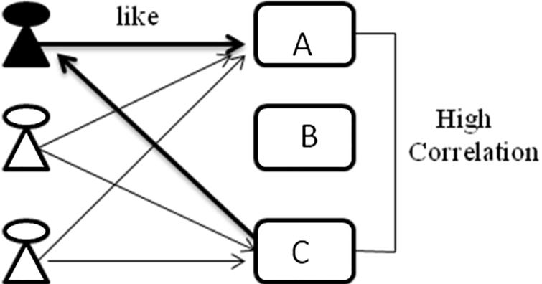
6. CF User based vs Item Based
Item Based

Slide 15
6. CF User based vs Item Based
The main different of these two types is the correlation itself, user based seek for the user similarity while item based used item similarity

Slide 16
6. CF Advantages
No domain knowledge necessary
The model can help users discover new interests. In isolation, the ML system may not know the user is interested in a given item, but the model might still recommend it because similar users are interested in that item.

Slide 17
6. CF Disadvantages
Data Sparsity
Scalability: Nearest neighbor algorithms require computation that grows with both the number of users and the number of items.

